Slide 1
Root Transform Local Linear Regression
Begad Elhouty¹, Samuel F. Feng², Tarek El-Fouly³, Bashar Zahawi³
¹ Learning Delivery & Field Support, Emirates School Establishment
² Department of Science & Engineering, Sorbonne University
³ Advanced Power & Energy Center,
Department of Electrical Engineering and Computer Science, Khalifa University

Slide 2
AGENDA
Motivation
Electric Load Data
Statistical Models
Assessment Methodology
Results
1
2
3
4
5

Slide 3
Motivation

Slide 4
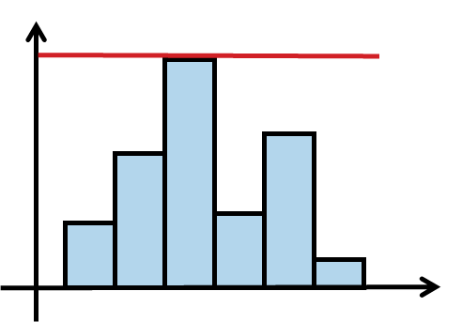
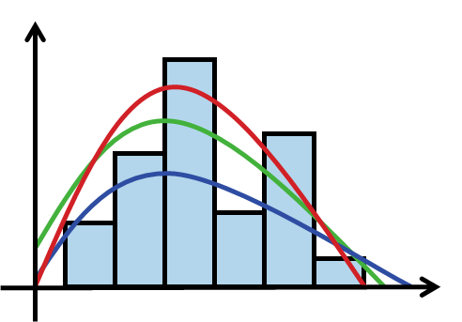



Electric Load Estimation
Problem Statement
Electric power networks try to strike a balance between meeting customer’s energy demand and maintain supply quality.
To combat this issue:
Traditionally
More Practical

Slide 5

Electric Load Estimation
Applications of Electric Load Estimation
Planning, operating and optimizing microgrids.
Optimal allocation of renewable distributed generation to minimize annual energy loss.
Evaluating the reliability and accuracy of power systems with PV power generation.
Integration of batteries with photovoltaic plants on a large scale.

Slide 6
Current Estimation Models
Parametric Models
Load Fluctuations are modelled in literature by various parametric distributions such as:
Gaussian [2]
Beta [3-4]
Weibull [5]
Log-Normal [5]
Erlang [5]
Without significant evidence, assuming electrical load data follows a Gaussian or Beta distribution is dangerous as it may lead to wrong analyses.
Nonparametric Models
To address the rigid assumptions of parametric distributions and improve accuracy of estimation, electric load has been modelled by nonparametric distributions:
Gaussian Mixture Models [6]
Bayesian Approaches [7]

Slide 7
Proposed RTLLR Method
We propose a nonparametric method called Root Transform Local Linear Regression (RTLLR) for estimating electric load data. RTLLR is easy to use and computationally efficient.
Intensive comparative analysis with traditional parametric and nonparametric load density estimation models is conducted.

Slide 8
Electric Load Data

Slide 9

Electric Load Data
Data collected from the Customer-Led Network Revolution based in UK.
567 Enterprise locations analyzed.
Only locations with a year’s worth of data analyzed
Electric Power in kWh was collected per half-hour intervals.
Enterprises were divided further into sectors and number of employees.
Notes:
http://www.networkrevolution.co.uk/resources/project-data/

Slide 10
Statistical Models

Slide 11
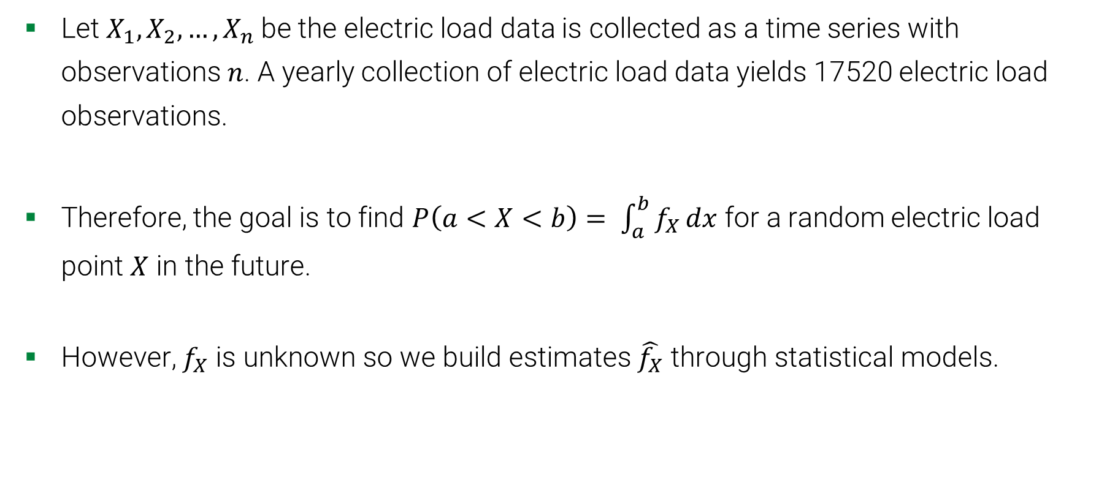
The Statistical Problem
Let $X_{1},X_{2},…,X_{n}$be the electric load data is collected as a time series with observations $n$. A yearly collection of electric load data yields 17520 electric load observations.
Therefore, the goal is to find $P\left(a<X<b\right)= \int_{a}^{b}{f_{X}}dx$ for a random electric load point $X$ in the future.
However, $f_{X}$ is unknown so we build estimates $\hat{f_{X}}$ through statistical models.
Notes:
Power system planning and optimization requires accurately estimating probabilities at random points in the future during the life of a power network.

Slide 12

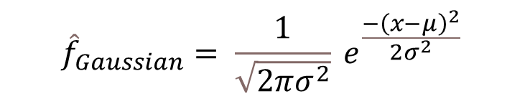
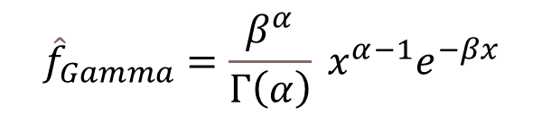
Parametric Models
We studied the Gaussian & Gamma models.
$${\hat{f}}_{Gaussian}= \frac{1}{\sqrt{2πσ^{2}}} e^{\frac{−{\left(x−μ\right)}^{2}}{2σ^{2}}}$$
with mean $μ$ and variance $σ^{2}$.
$${\hat{f}}_{Gamma}=\frac{β^{α}}{Γ\left(α\right)} x^{α−1}e^{−βx}$$
with shape $α$ and rate $β$ parameters.
Parametric models are interpretable and simpler to fit
Parametric models have high bias due to having rigid assumptions.
Notes:
Parameters were found through Maximum Likelihood Estimation

Slide 13
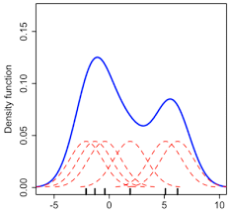
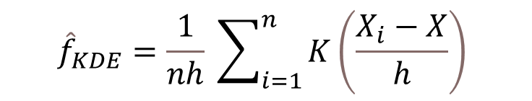
Nonparametric Models
Kernel Density Estimators (KDE)
$${\hat{f}}_{KDE}=\frac{1}{nh} \sum_{i=1}^{n}{K\left(\frac{X_{i}−X}{h}\right)}$$
We use 2 Rule-Of-Thumb formulas for $h$:
$h_{ROT2}=\hat{σ}×n^{−\frac{1}{6}}$
$h_{ROT1}=1.059×\hat{σ}×n^{−\frac{1}{5}}$
KDE has lower bias than parametric models.
KDE suffers from boundary bias.
Notes:
Choice of $K$ is not as important as bandwidth $h$.

Slide 14
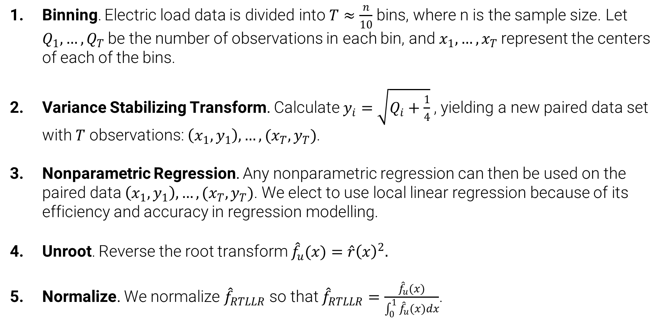
Root Transform Local Linear Regression
Binning. Electric load data is divided into $T≈\frac{n}{10}$ bins, where n is the sample size. Let $Q_{1},…,Q_{T}$be the number of observations in each bin, and $x_{1},…,x_{T}$represent the centers of each of the bins.
Variance Stabilizing Transform. Calculate $y_{i}=\sqrt{Q_{i}+\frac{1}{4}}$ , yielding a new paired data set with $T$ observations: $\left(x_{1},y_{1}\right),…,(x_{T},y_{T})$.
Nonparametric Regression. Any nonparametric regression can then be used on the paired data $\left(x_{1},y_{1}\right),…,(x_{T},y_{T})$. We elect to use local linear regression because of its efficiency and accuracy in regression modelling.
Unroot. Reverse the root transform ${\hat{f}}_{u}(x)=\hat{r}{\left(x\right)}^{2}.$
Normalize. We normalize ${\hat{f}}_{RTLLR}$ so that ${\hat{f}}_{RTLLR}=\frac{{\hat{f}}_{u}(x)}{\int_{0}^{1}{{\hat{f}}_{u}(x)}dx}$.

Slide 15
Assessment Methodology

Slide 16

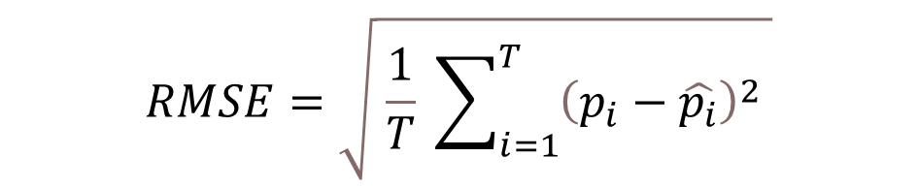
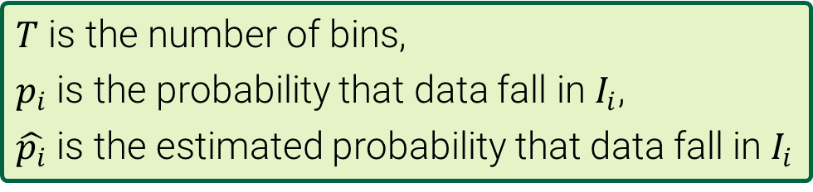
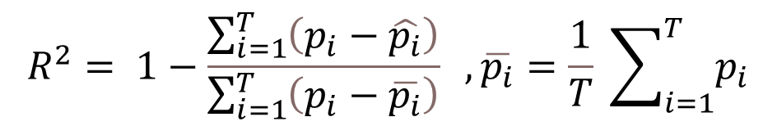
Error Metrics
Kolmogorov-Smirnov Test
$$RMSE=\sqrt{ \frac{1}{T} \sum_{i=1}^{T}{{\left(p_{i}−\hat{p_{i}}\right)}^{2}} }$$
$T$ is the number of bins,
$p_{i}$ is the probability that data fall in $I_{i}$,
$\hat{p_{i}}$ is the estimated probability that data fall in $I_{i}$
$$MAE=\frac{1}{T} \sum_{i=1}^{T}{\left|p_{i}−\hat{p_{i}}\right|}$$
$$R^{2}= 1−\frac{\sum_{i=1}^{T}{\left(p_{i}−\hat{p_{i}}\right)}}{\sum_{i=1}^{T}{\left(p_{i}−\overline{p_{i}}\right)}} , \overline{p_{i}}=\frac{1}{T} \sum_{i=1}^{T}{p_{i}}$$

Slide 17
Results

Slide 18
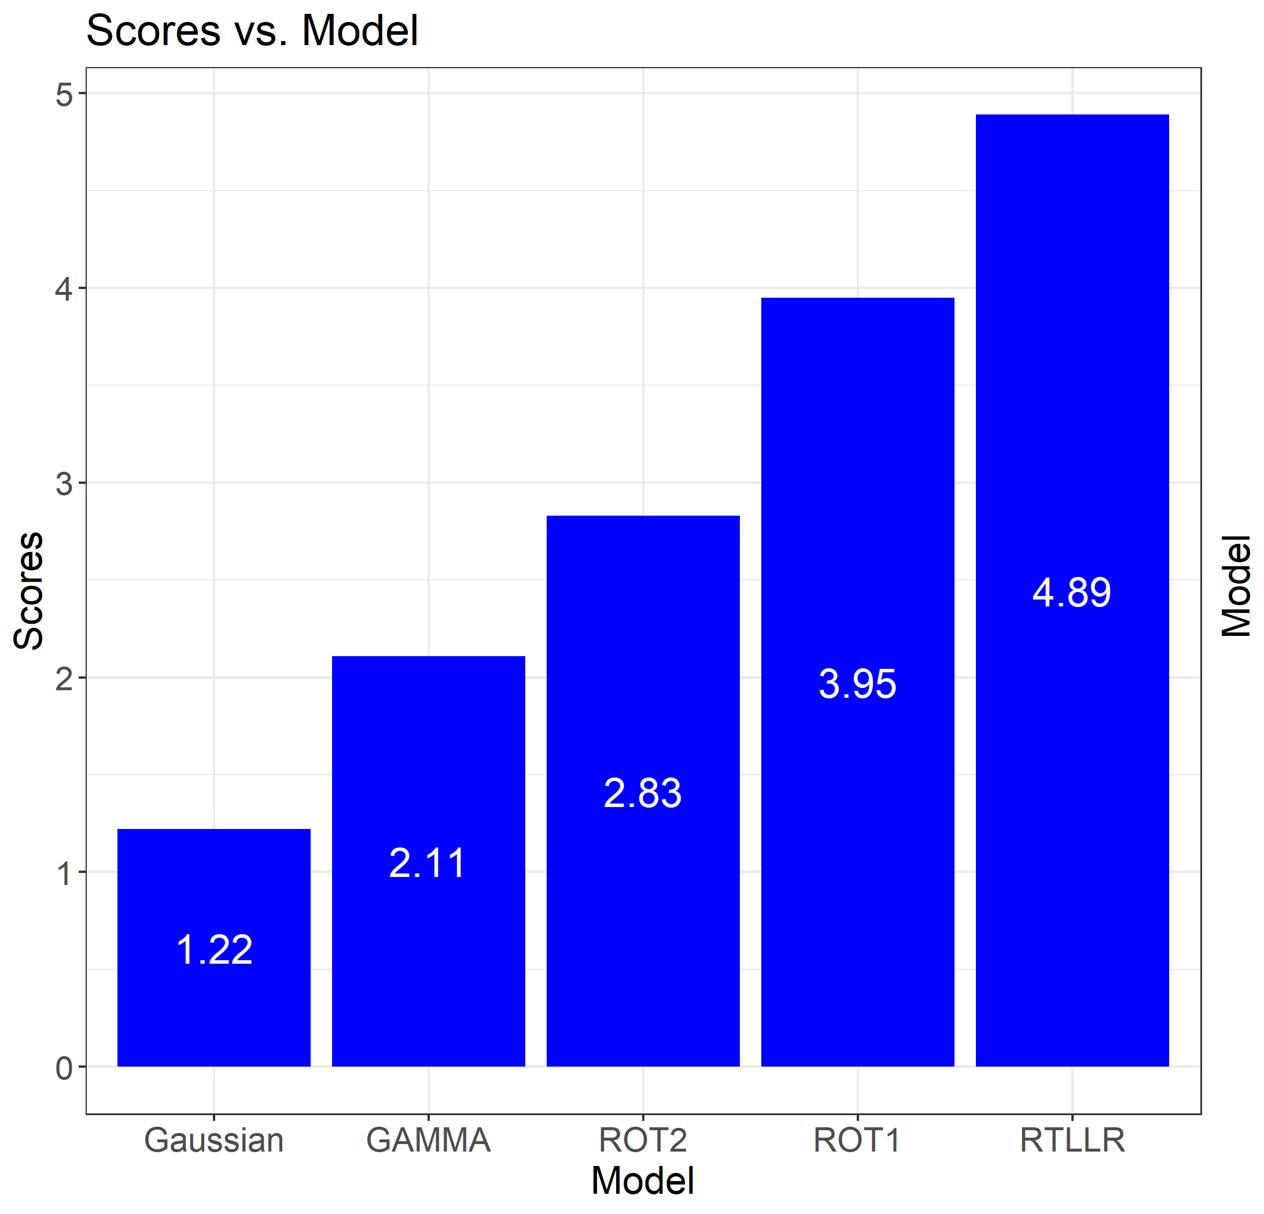
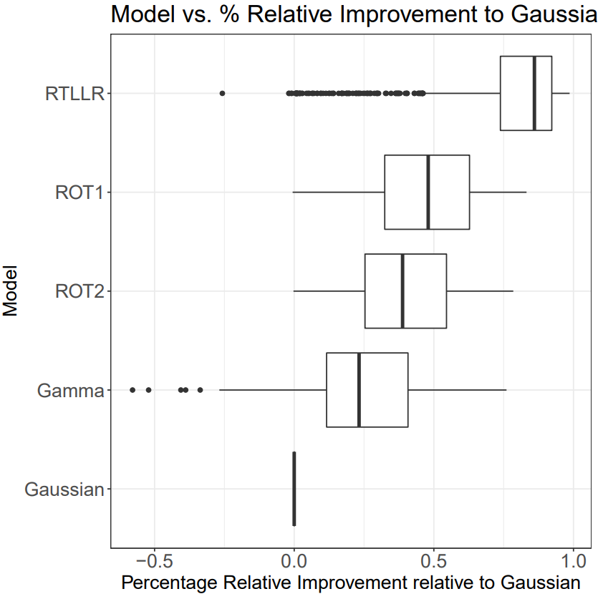
RMSE Results
Notes:
Scores present which model preformed the best across one location.
RTLLR has the highest RMSE score.
Relative percentage improvement seems the best for RTLLR as well.
KDE models preform better than parametric models.
Gamma does worse in multiple locations.
MAE results are very similar to RMSE

Slide 19
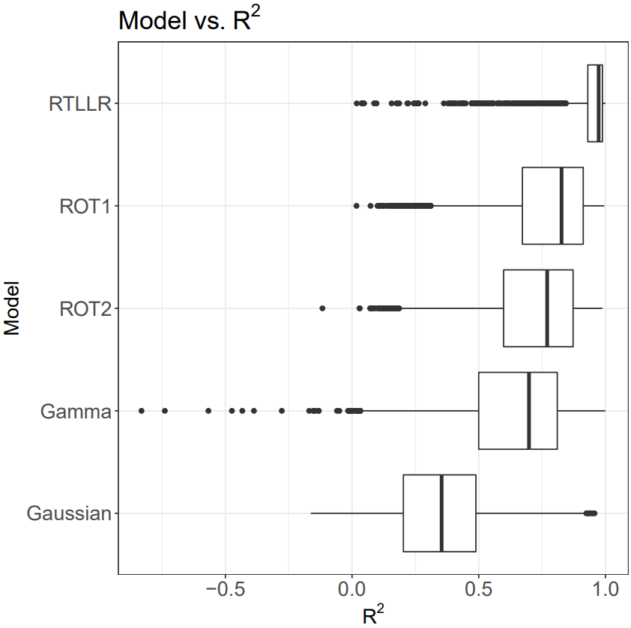
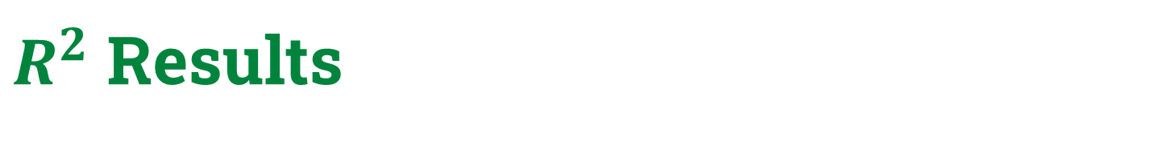
$R^{2}$ Results
Enterprise | R²
 | Average | Maximum
CO | 91% | 100%
IND | 91% | 100%
PSO | 93% | 100%
AHFF | 98% | 100%
Average and Maximum values for $R^{2}$
Notes:
Scores present which model preformed the best across one location.
RTLLR has the highest $R^{2}$ score.
RTLLR has the narrowest interquartile range with the highest mean. KDE models preform better than parametric models.
Gamma seems unreliable cause of negative $R^{2}$ values.

Slide 20
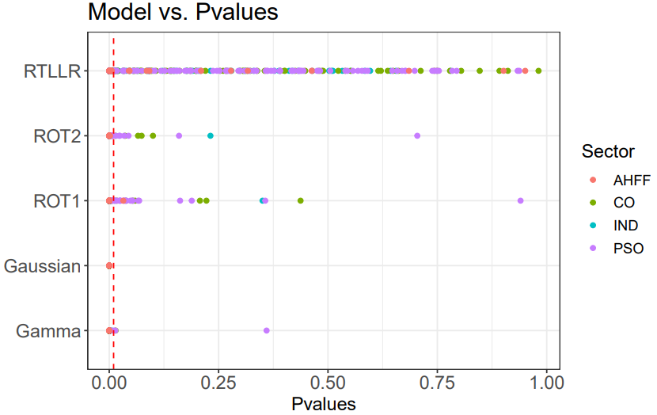
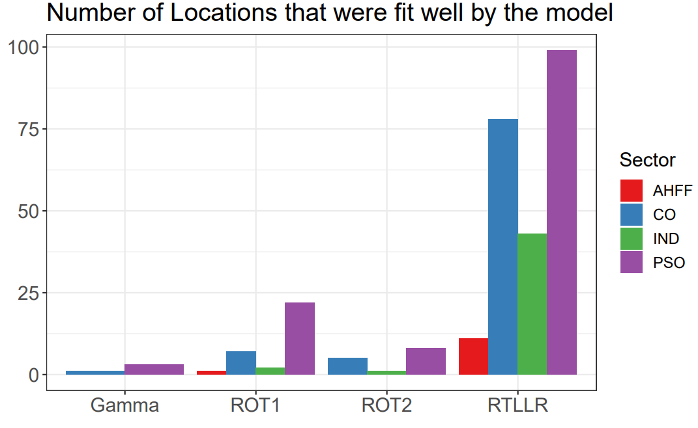
KS Test Results
Notes:
RTLLR has seems to have the highest p-values followed by the KDE models.
More locations are fit well by RTLLR in terms of the KS test p-value ($α>0.01$).
KDE models preform better than parametric models.
None of the parametric models pass the threshold for any location.

Slide 21
Probability Density Estimation Project
PDEP App

Slide 22
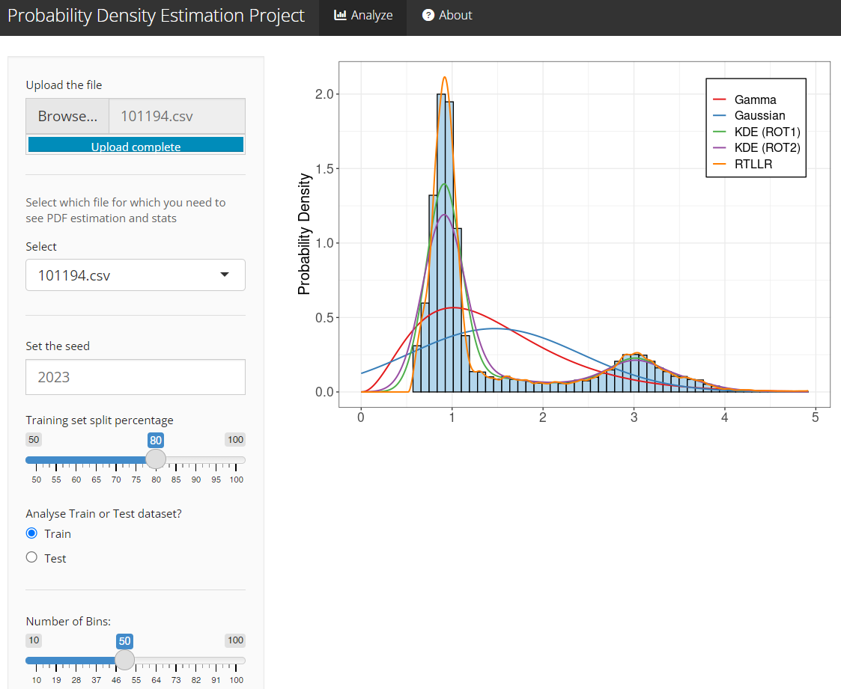
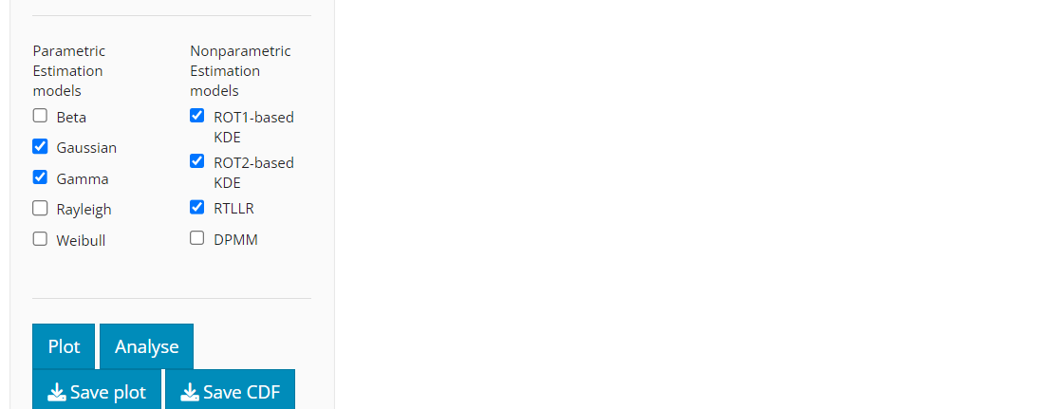
PDEP Web Application
Features of the application include:
Split provided dataset into train and test.
Vary the train split percentage.
Vary the seed
Plot a selection of various parametric and nonparametric models
Obtain error metrics for all models chosen
Download plots
Download CDF values for all models.

Slide 23
Conclusion

Slide 24
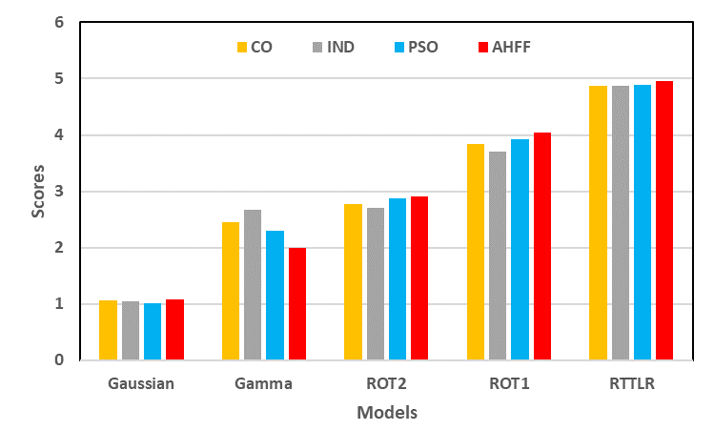

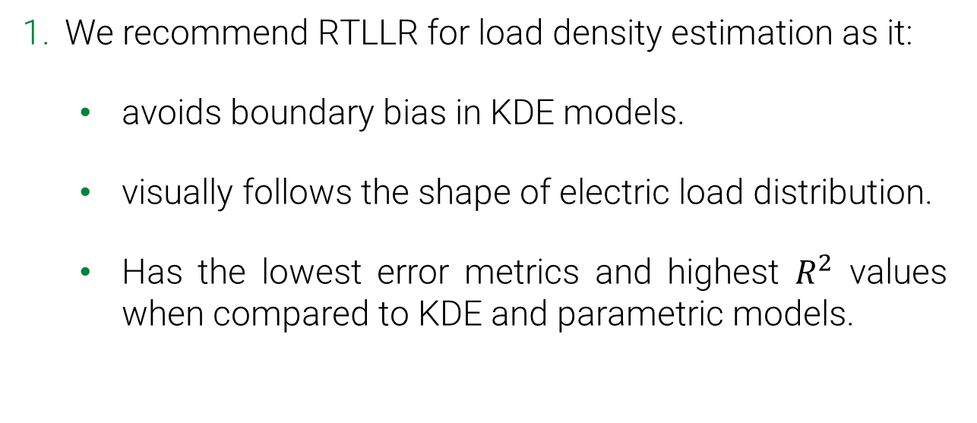
Conclusion
We recommend RTLLR for load density estimation as it:
avoids boundary bias in KDE models.
visually follows the shape of electric load distribution.
Has the lowest error metrics and highest $R^{2}$ values when compared to KDE and parametric models.
2. You can use an open-source web application to recreate our analysis on any data.
https://pdep.shinyapps.io/pdep_app/
Notes:
To conclude, this project assessed the performance of 2 parametric models, namely Gaussian and Gamma, with 3 non parametric models, 2 KDE models and RTLLR.
Further research needed to investigate the performance of RTLLR in power systems planning and optimization studies.

Slide 25
Thank You
I would like to specially thank family, friends and the team for advising me throughout the project.

Slide 26
Appendix

Slide 27
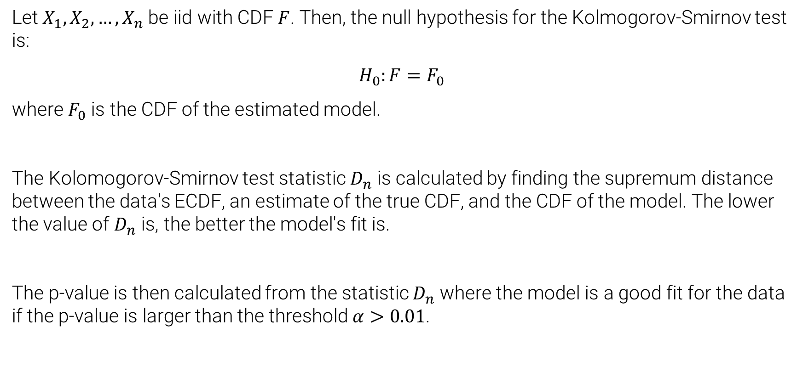
Kolmogorov-Smirnov Test
Let $X_{1},X_{2},…,X_{n}$be iid with CDF $F$. Then, the null hypothesis for the Kolmogorov-Smirnov test is:
$$H_{0}:F=F_{0}$$
where $F_{0}$ is the CDF of the estimated model.
The Kolomogorov-Smirnov test statistic $D_{n}$ is calculated by finding the supremum distance between the data's ECDF, an estimate of the true CDF, and the CDF of the model. The lower the value of $D_{n}$ is, the better the model's fit is.
The p-value is then calculated from the statistic $D_{n}$ where the model is a good fit for the data if the p-value is larger than the threshold $α>0.01$.

